Slide 1
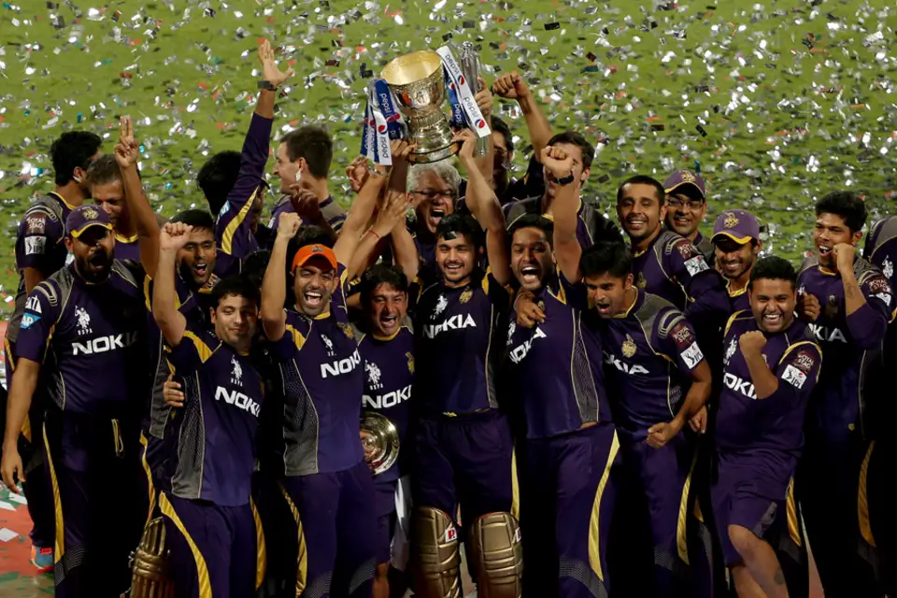


Kolkata Knight Riders
IPL SQUAD SELECTION
TEAM 10
BABITHA RAJU (2301013)
DIA MAJUMDER (2301021)
CHIRADIP LAHIRI (2301258)
DEBASHRUTI BHATTACHARJEE (2301259)
J GOWRISHANKAR (2301342)

Slide 2

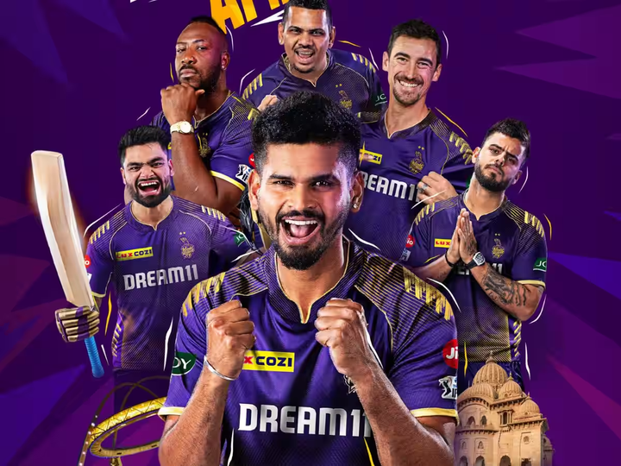
PROBLEM STATEMENT
OBJECTIVE
To select the squad for the upcoming IPL season for the defending champions based on previous season’s performance
Last Year Defending Champions : Kolkata Knight Riders
DATA AVAILABLE
22 Domestic/Foreign Players who played for KKR for IPL 2024
Categories: All-Rounders, Bowlers, Batsmen
Input: Age, Matches Played, Batting Strike Rate, Bowling Strike Rate, Economy
Output: Catches, Runs Scored, Wickets, Impact Points
Using the above criteria, we are further segmenting them under Cost and Benefit criteria
Cost Criteria: Age, Bowling Strike Rate, Cost of the player, Bowling Average, Economy
Benefit Criteria: No. of Matches Played, Batting Strike Rate, Batting Average, Catches, Runs scored, wickets taken, impact points
Data Sources: IPLT20.com, ESPN CricInfo, Cricbuzz

Slide 3
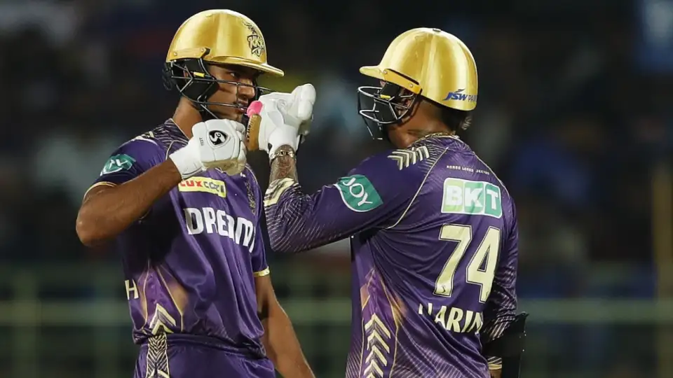

ASSUMPTIONS & WORKING METHODOLOGIES
Assumption 1:The players will be bought at the same price as last year in the auctions.
Assumption 2: All the players we have considered will be available during auctions
Assumption 3: The weights of the criteria were given after deliberating on its importance
Assumption 4: The amount available for retention of 6 players from the current squad is 63 cr
Assumption 5: Among the 6 players retained , 2 are needed from each - AR, Bowlers, Batsmen
Analysing the relative efficiency of the players
Among the top 24 squad players under consideration, we will be using DEA to identify the most efficient players under each category
Ranking the players according to the Weights
For each category, TOPSIS has been performed to identify the top performing players who are scoring consistently in the given criteria
To fulfill the necessary condition of the squad
By using Binary Goal Programming has been used to identify the players who are finally included in the team

Slide 4
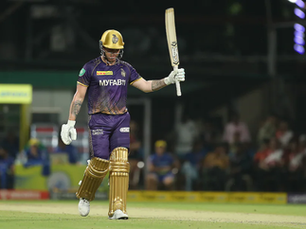
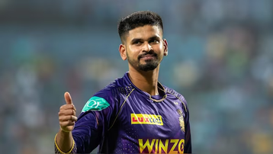

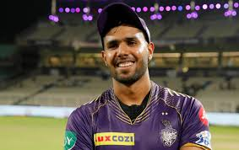
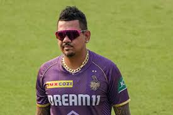
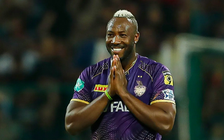
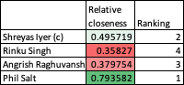
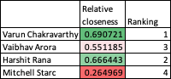
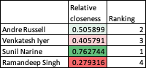
ANALYSIS
Batters
Bowlers
All-Rounders
Players advised to be retained after DEA & TOPSIS Analysis
Phil Salt
Shreyas
Iyer
Varun
Chakravarthy
Harshit Rana
Sunil Narine
Andre Russell
TOPSIS Ranking
Batters
Bowlers
All-Rounders
Purse Remaining after Retentions ----> Rs 57 Crore
Purse that can be used according
to Binary analysis ----> Rs 53.1 Crore
Amount left in the Purse ----> Rs 3.9 Crore
Batters
Bowlers
All-Rounders
Retained
Mega Auction
Squad Structure for IPL 2025
8
7
8
6
17

Slide 5
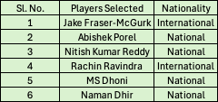
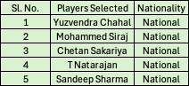
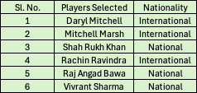



RECOMMENDATION & BUSINESS IMPACT
Players to Watch Out at Mega Auction
Business Impact
Batters
Bowlers
All-Rounders
Accurate estimation and selection of top-performing players, especially all-rounders, can significantly improve the team's balance.
Leveraging data from previous performances can lead to more strategic picks, ensuring a balanced team with reliable performers in crucial situations.
Optimizing the budget during auctions by prioritizing players who provide high impact at a reasonable cost is essential.
Investing in younger, emerging players or underutilized talent with high potential (as indicated by impact scores) ensures the team’s long-term stability.
Selection decisions that align with the franchise’s brand and performance goals help in building strategic partnerships.
The remaining Rs 3.9 crores in the purse can be used to buy talented uncapped Indian Players in the Auction.
Scouting for more local talents can be done, which will improve the bench strength.
Invest more on local players which will also help in the growth of Indian Cricket.

